Slide 1

Sensing Global Happiness, Diurnal Rhythms and Topics Through Social Media (Twitter)
WEN610 Environmental Sampling and Data Analysis – Fall 2014
Aamena Ali Al shamsi,
Vahan Babushkin,
Vimitha Manohar

Slide 2
Motivation
Twitter has 284 million monthly active users [1]
500 million Tweets are sent per day [1]
Social Media could reveal some human activities, emotions and interests
We studied three global variables
Happiness
Diurnal Rhythms (number of tweets at different times of the day)
Topics
[1]https://about.twitter.com/company
Notes:
The reason why we selected Twitter is that it is very common globally
Because people report their feelings, interests and show their activities, we leveraged those tweets to study some patterns

Slide 3
Assumptions
We clustered countries into 4 strata according to their human development index (HDI) [2]
HDI itself include many dimensions
Education
Health
and income
We assume that countries that are similar according to the (HDI) share common patterns measured through social media (tweets)
We assume that there is a heterogeneity between countries in terms of the studied variables
[2] Malik, Khalid. "Human development report 2013. The rise of the South: Human progress in a diverse world." http://hdr.undp.org/en/global-reports (2013).

Slide 4
Strata
We used K-mean clustering to make sure that there is homogeneity within a stratum and heterogeneity between strata.
Cluster | Number of Countries | HDI range
1 | 33 | 0.83- 0.944
2 | 38 | 0.731-0.827
3 | 25 | 0.614-0.722
4 | 18 | 0.393-0.586

Slide 5
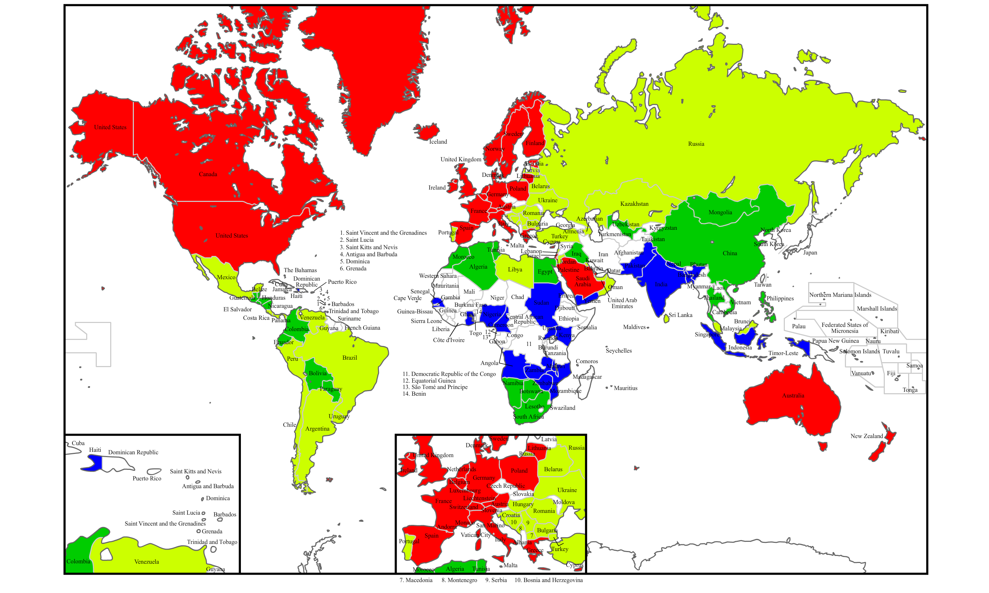
Countries clustered by 4 strata
Stratum 1
Stratum 2
Stratum 3
Stratum 4

Slide 6
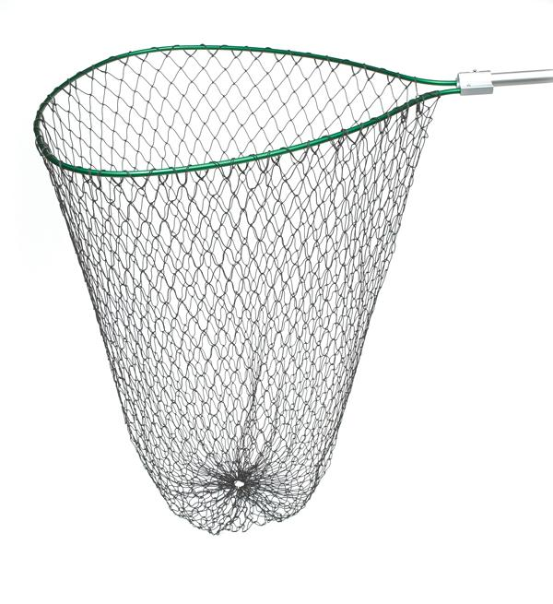
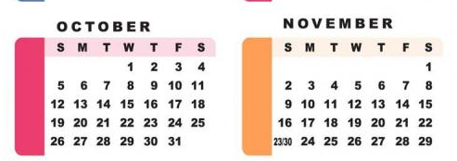
Sampling Methods
Systematic Sampling (6 days)
Cluster Sampling
(30 days)
Stratified Sampling

Slide 7


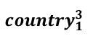
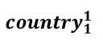
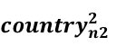
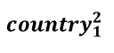
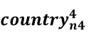
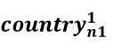
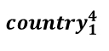
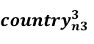
Schematic diagram of stratified sampling procedure
THE WHOLE WORLD
STRATUM 1
STRATUM 2
STRATUM 3
STRATUM 3
$${country}_{1}^{1}$$
……
$${country}_{n1}^{1}$$
$${country}_{1}^{2}$$
……
$${country}_{n2}^{2}$$
$${country}_{1}^{3}$$
……
$${country}_{n3}^{3}$$
$${country}_{1}^{4}$$
……
$${country}_{n4}^{4}$$
…
…
…
…
…
…
…
…
tweets
tweets
tweets
tweets
tweets
tweets
tweets
tweets

Slide 8
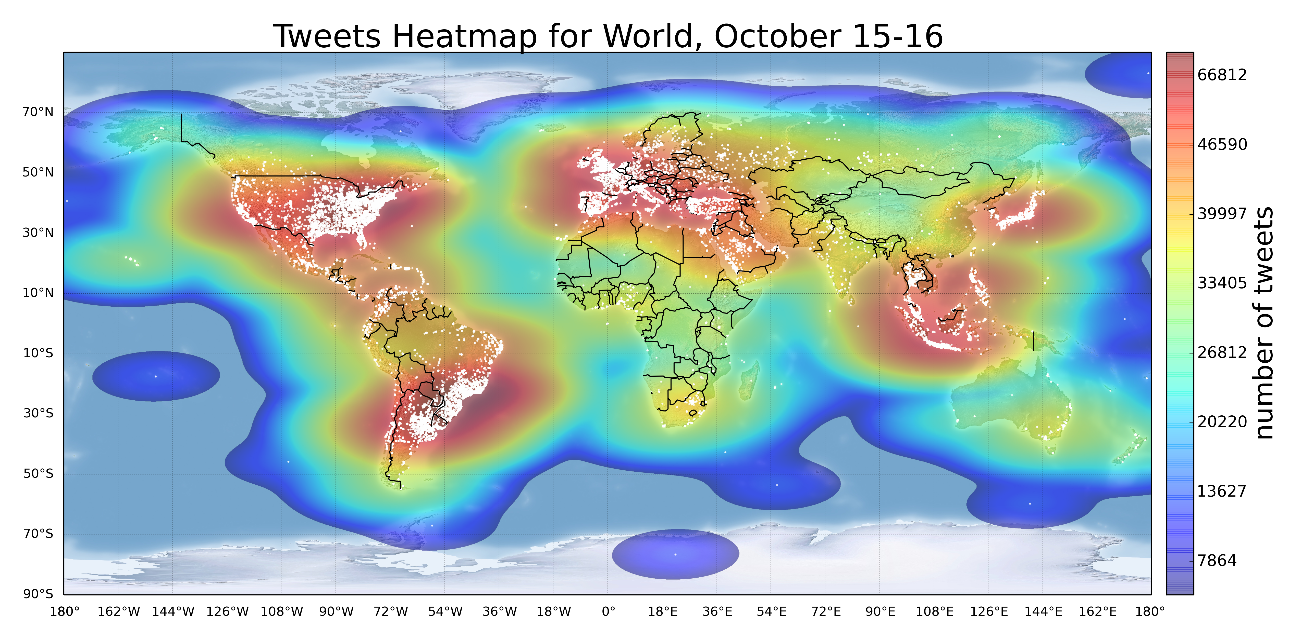
Pre-Sampling
One day: Geo-located tweets are 10% of the total tweets
Cluster | Number of Tweets | Number of Users | Total Population in millions [2]
1 | 32,399 | 28,758 | 2,277.7 million
2 | 29,553 | 25,569 | 2,256.4 million
3 | 5,308 | 4,733 | 986 million
4 | 5,006 | 4,697 | 1,091 million

Slide 9
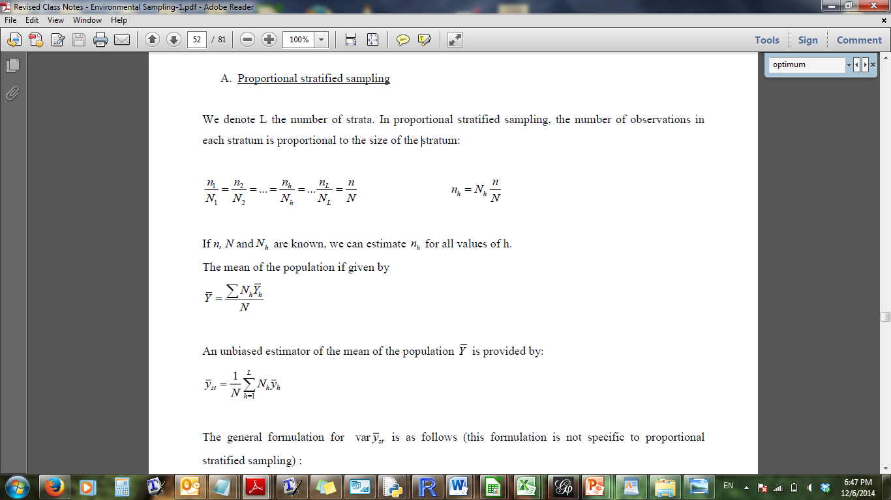
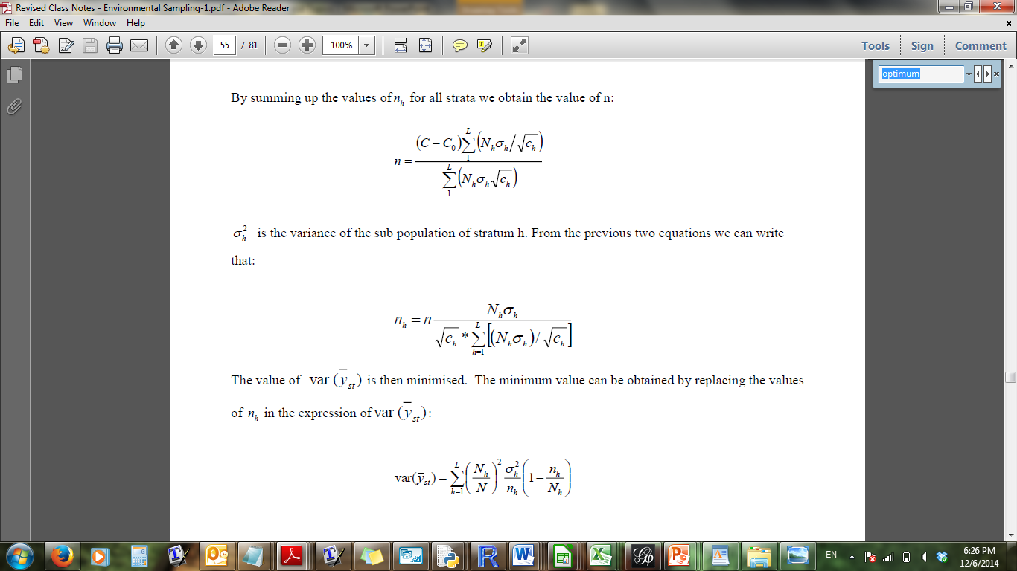
Pre-Sampling
Stratified Sampling
Cost of each stratum (Ch):
The time needed to collect and process each tweet
Total Population of (Nh):
The reported population of countries in the stratum [1]
Standard Deviation ($σ_{h}$):
The standard deviation of the variable of interest
Total number of samples (n):
The number of samples in the pre-sample * 6 days
Notes:
You might notice that the number of tweets that we got is smaller than the expected number.
There are two ways to get the tweets: (1) Twitter API (2) Firehose
Studies have estimated that using Twitter’s Streaming API users can expect to receive anywhere from 1% of the tweets to over 40% of tweets in near real-time while using the firehose you can only get part of the data (clustering data)

Slide 10
Pre-Sampling
Sampling | Cluster 1 | Cluster 2 | Cluster 3 | Cluster 4
Optimum Sampling (happiness) | 168,433 | 134,404 | 33,455 | 46,250
Proportional Sampling | 131,795 | 130,563 | 57,053 | 63,129
Collected Samples | 204,981 | 172,293 | 43,524 | 48,721
Standard Deviation of Pre-sampling (happiness) | 0.194 | 0.165 | 0.219 | 0.275
Standard Deviation after sampling (happiness) | 0.14 | 0.13 | 0.11 | 0.08
Notes:
We plotted the geocoded tweets (latitude and longitude) and we mapped them to their corresponding countries
You can see that not all of the countries have a lot of tweets may because some countries has banned Twitter e.g. North Korea. Probably, people tweet through VPNs. Also, due to privacy reasons, many users do not reveal their locations

Slide 11
Happiness
Happiness of nations contribute to their development [3]
Hypothesis 1: Different Strata have different happiness levels
We used a common approach called hedonometer to calculate the happiness of countries and therefore strata using collected tweets [4]
Took the average of each country
Took the average per stratum
[3] Leyden, K.M., Goldberg, A., Michelbach, P.: Understanding the pursuit of happiness in ten major cities. Urban Aairs Review 47(6), 861{888 (2011)
[4] Dodds, Peter Sheridan, et al. "Temporal patterns of happiness and information in a global social network: Hedonometrics and Twitter." PloS one 6.12 (2011): e26752.

Slide 12
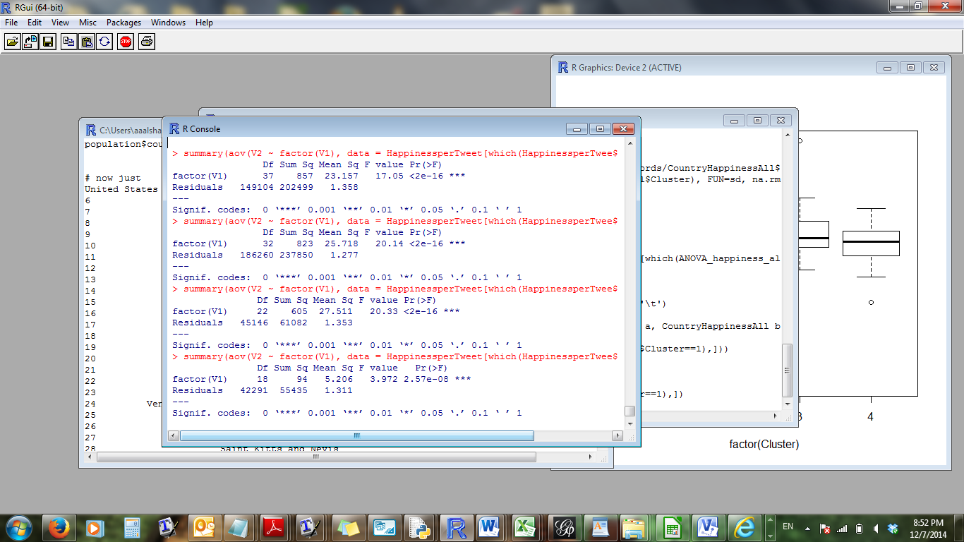
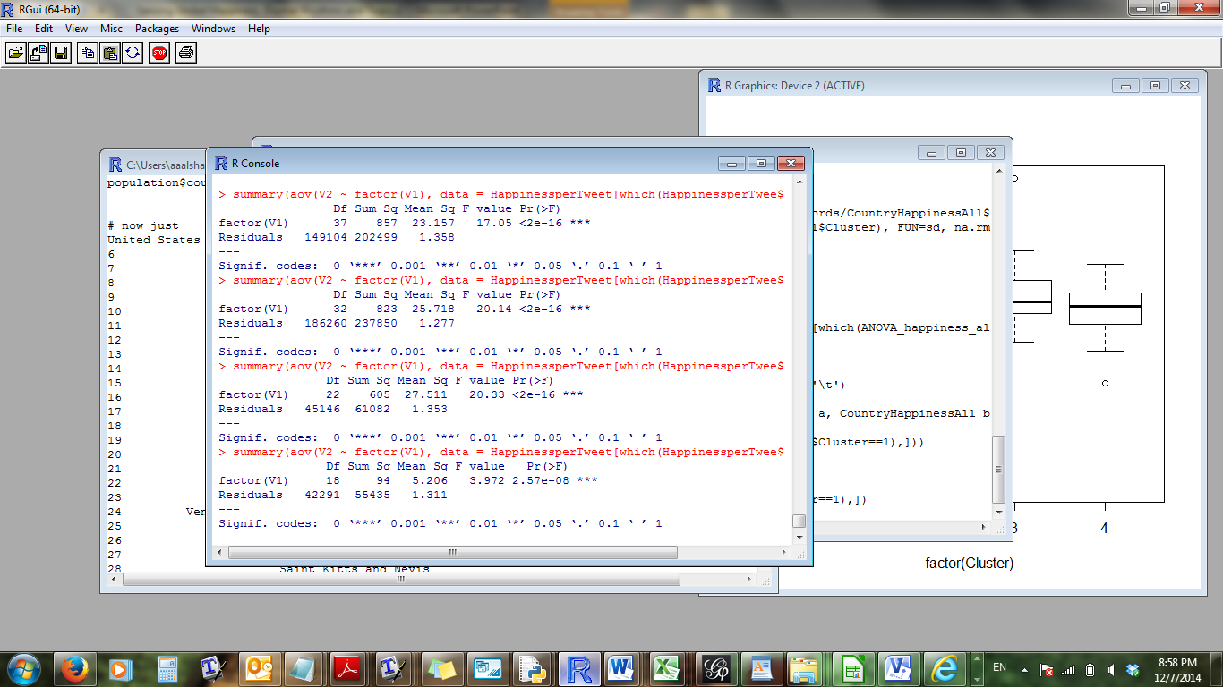
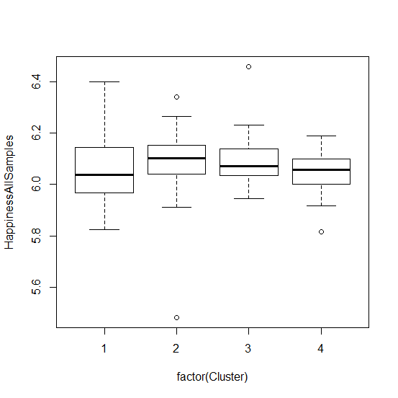
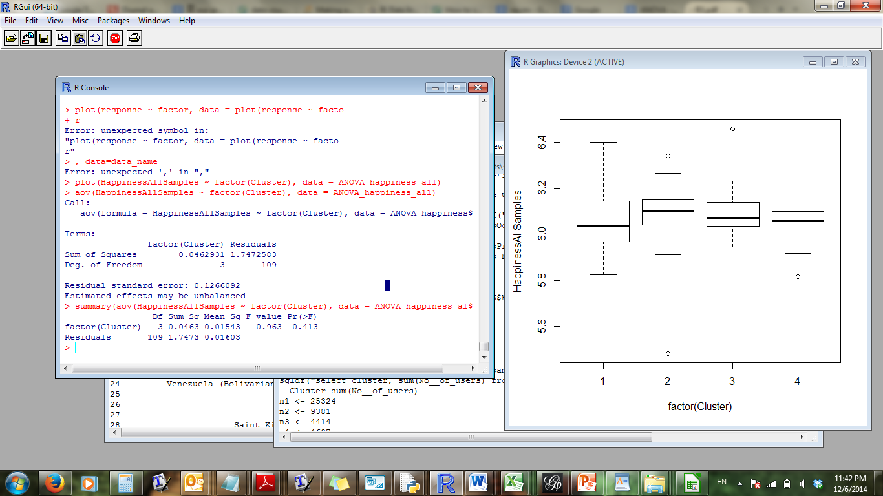
Results of Happiness
ANOVA Results
Stratum 1
Stratum 2
Stratum 3
Stratum 4
We reject hypothesis 1
Homogeneity within strata
We reject hypothesis 2
Heterogeneity between strata
null hypothesis of equal group variances

Slide 13
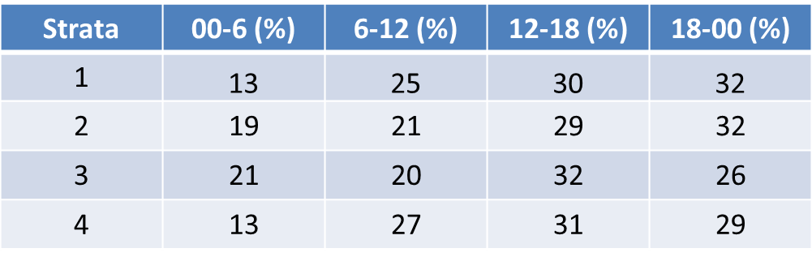
Diurnal Rhythms
Hypothesis 2: Different Strata have different Diurnal Rhythms levels
[5] Golder, Scott A., and Michael W. Macy. "Diurnal and seasonal mood vary with work, sleep, and daylength across diverse cultures." Science 333.6051 (2011): 1878-1881.
.

Slide 14
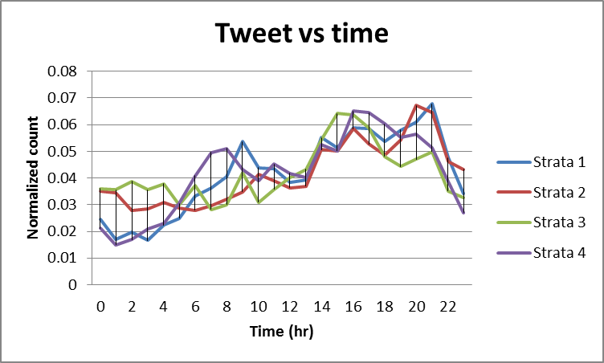
Results of Diurnal Rhythms

Slide 15
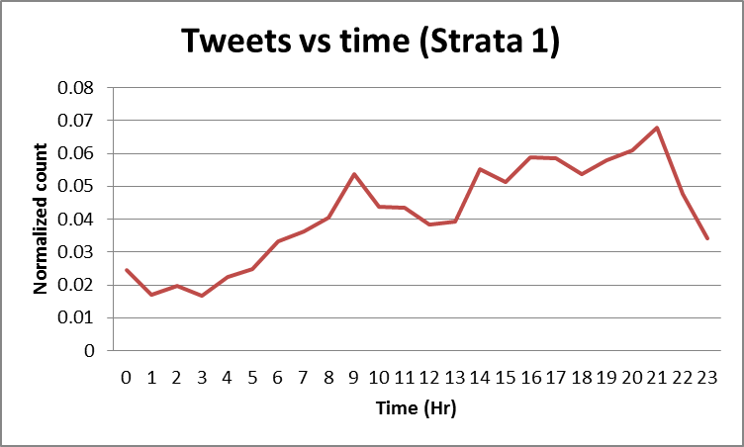
ANOVA
Source | SS | df | MS | F | P-value | F crit
Between Groups | 0.49 | 3 | 0.163351 | 16.67987 | 2.18E-09 | 2.665729
Within Groups | 1.449 | 148 | 0.009793
Total | 1.939 | 151
Groups | Count | Sum | Avg | Var
00-6 | 38 | 7.05 | 0.185434 | 0.019624
6-12 | 38 | 7.8 | 0.205185 | 0.007677
12-18 | 38 | 10.8 | 0.285494 | 0.003413
18-00 | 38 | 12.3 | 0.323886 | 0.008459

Slide 16
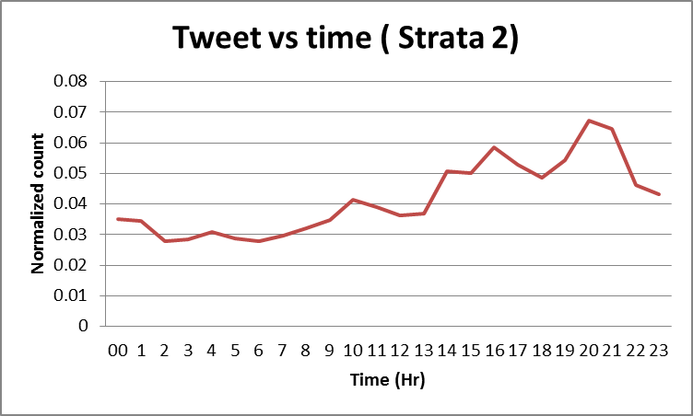
Source | SS | df | MS | F | P-value | F crit
Between Groups | 0.49 | 3 | 0.163351 | 16.67987 | 2.18E-09 | 2.665729
Within Groups | 1.449 | 148 | 0.009793
Total | 1.939 | 151
Groups | Count | Sum | Avg | Var
00-6 | 38 | 7.047 | 0.185 | 0.020
6-12 | 38 | 7.797 | 0.205 | 0.008
12-18 | 38 | 10.849 | 0.285 | 0.003
18-00 | 38 | 12.308 | 0.324 | 0.008

Slide 17
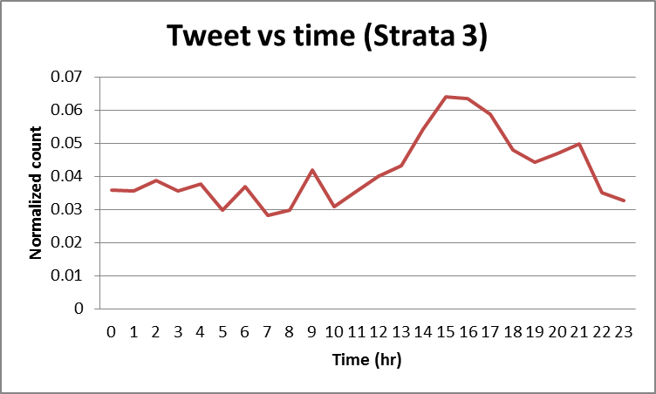
ANOVA
Source | SS | df | MS | F | P-value | F crit
Between Groups | 0.207 | 3 | 0.069096 | 5.75258 | 0.001219 | 2.708186
Within Groups | 1.057 | 88 | 0.012011
Total | 1.264 | 91
Groups | Count | Sum | Average | Variance
00-6 | 23 | 4.92187 | 0.213994 | 0.017546
6-12 | 23 | 4.696837 | 0.20421 | 0.009097
12-18 | 23 | 7.466223 | 0.324618 | 0.006387
18-00 | 23 | 5.91507 | 0.257177 | 0.015015

Slide 18
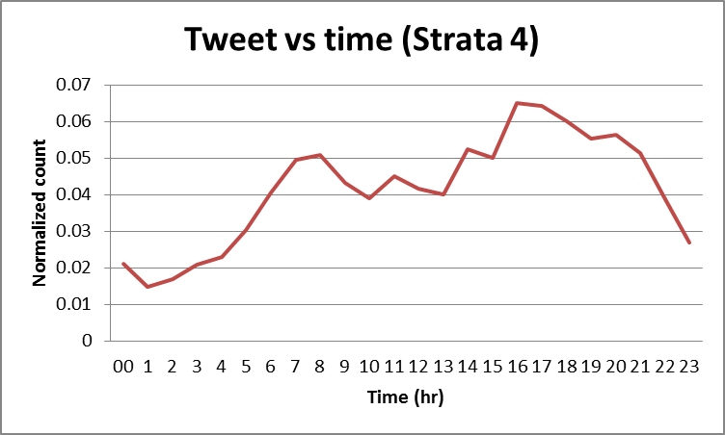
ANOVA
Source of Variation | SS | df | MS | F | P-value | F crit
Between Groups | 0.398371 | 3 | 0.13279 | 14.07101 | 2.6E-07 | 2.731807
Within Groups | 0.679476 | 72 | 0.009437
Total | 1.077847 | 75
Groups | Count | Sum | Avg | Var
00-6 | 19 | 2.427 | 0.128 | 0.006
6-12 | 19 | 5.108 | 0.269 | 0.008
12-18 | 19 | 5.968 | 0.314 | 0.005
18-00 | 19 | 5.498 | 0.289 | 0.020

Slide 19
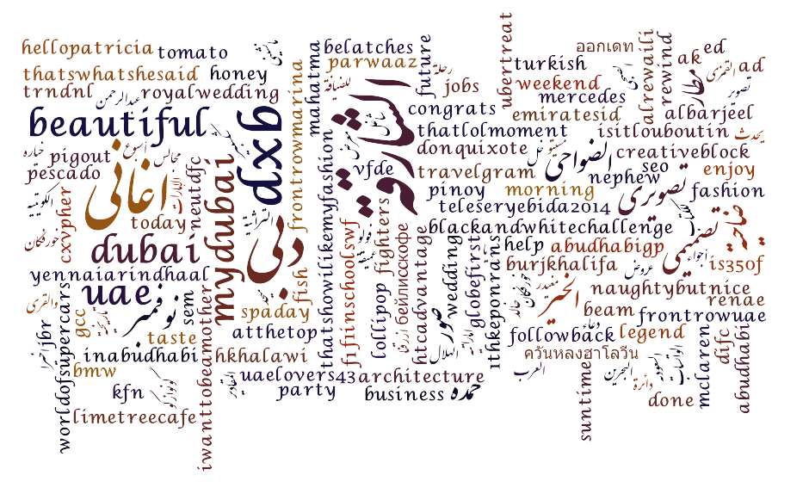
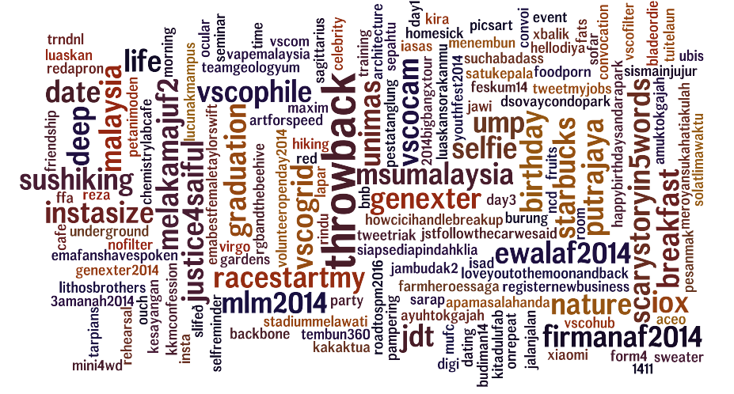
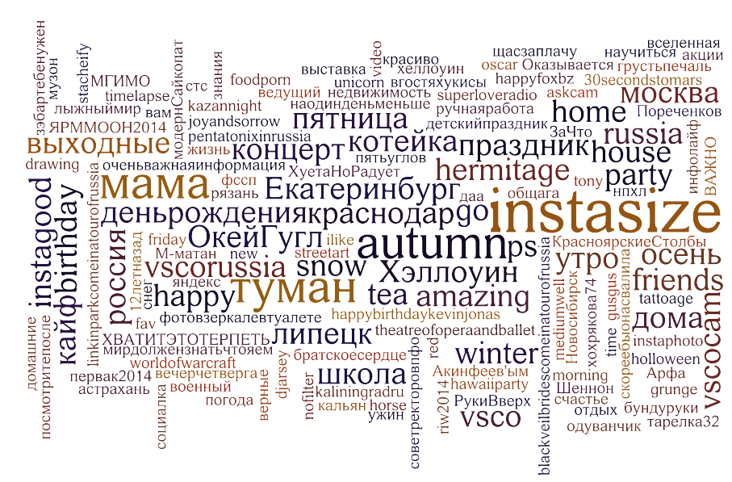
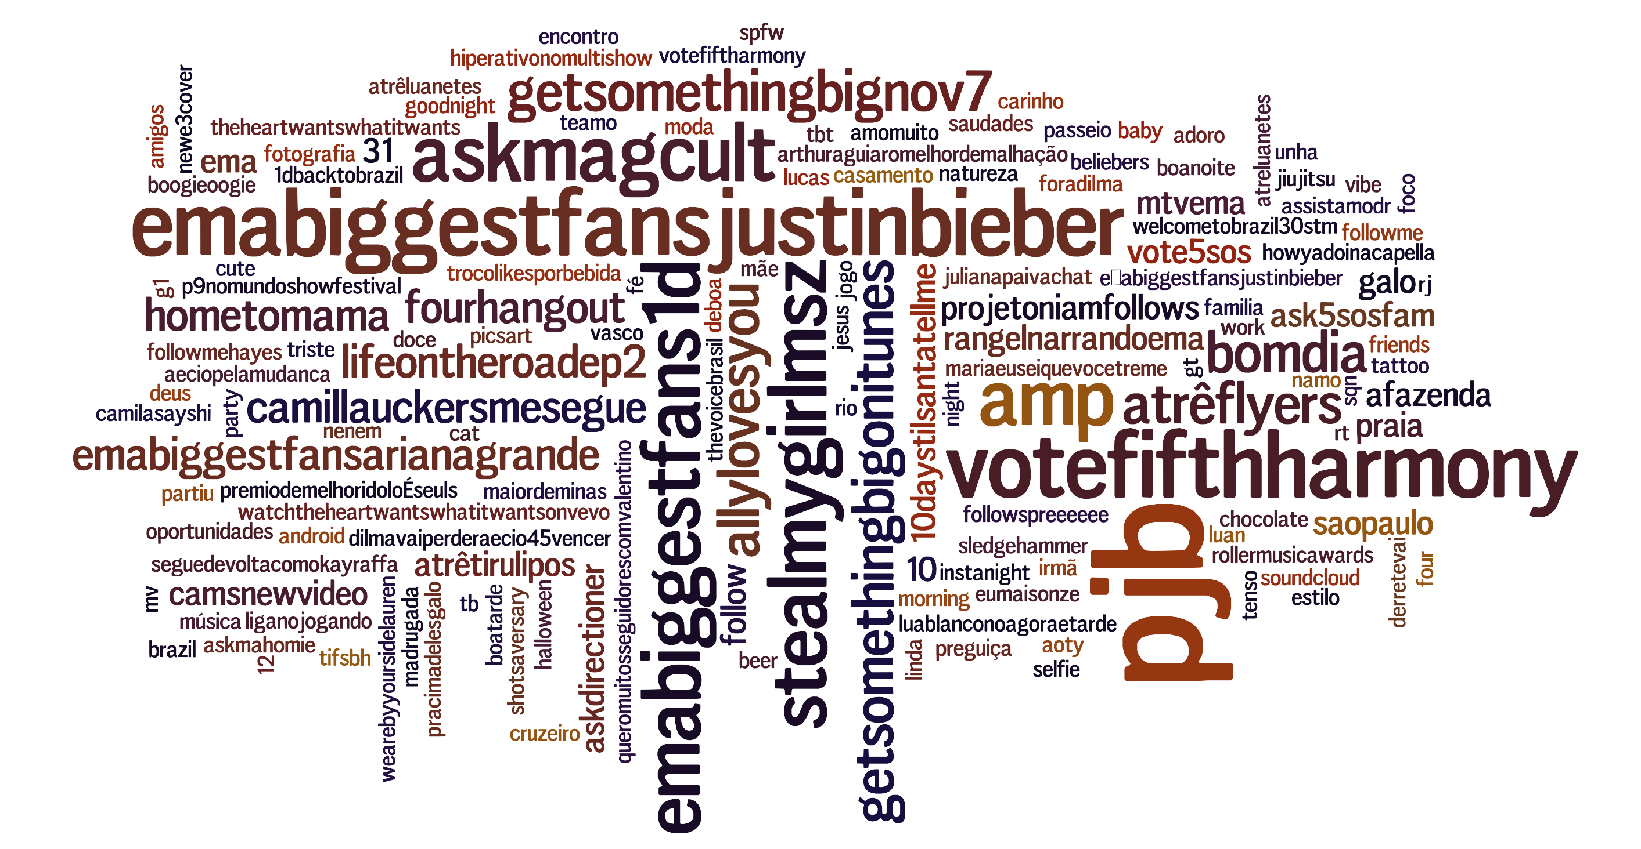
Topics of Interest
United Arab Emirates
Malaysia
Brazil
Russia

Slide 20
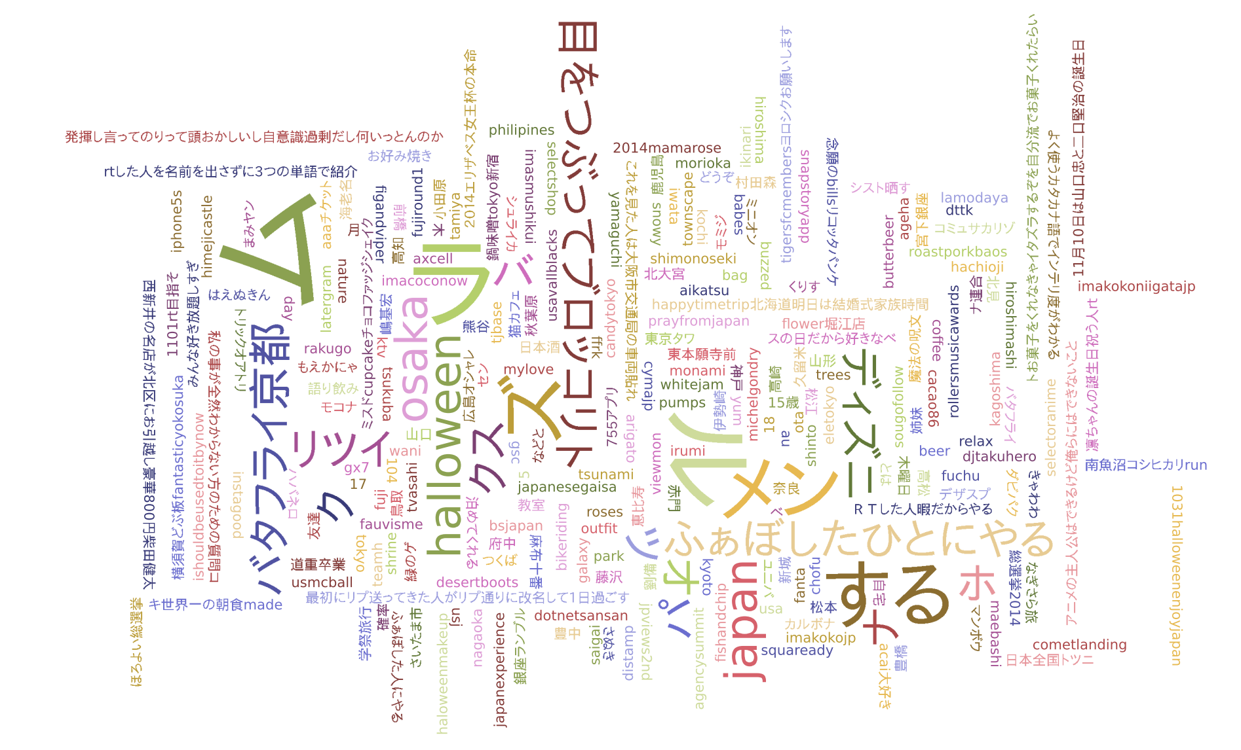
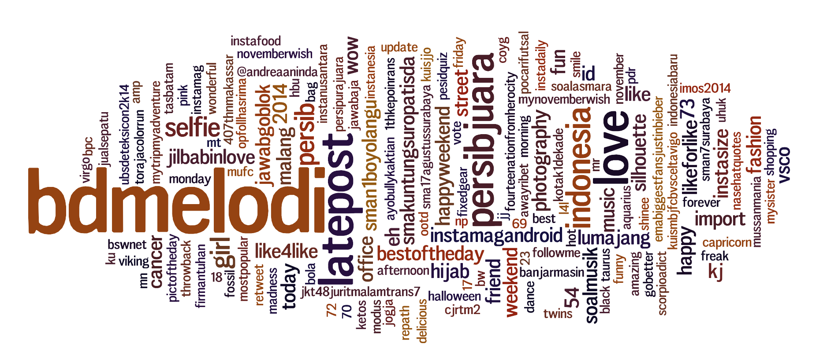
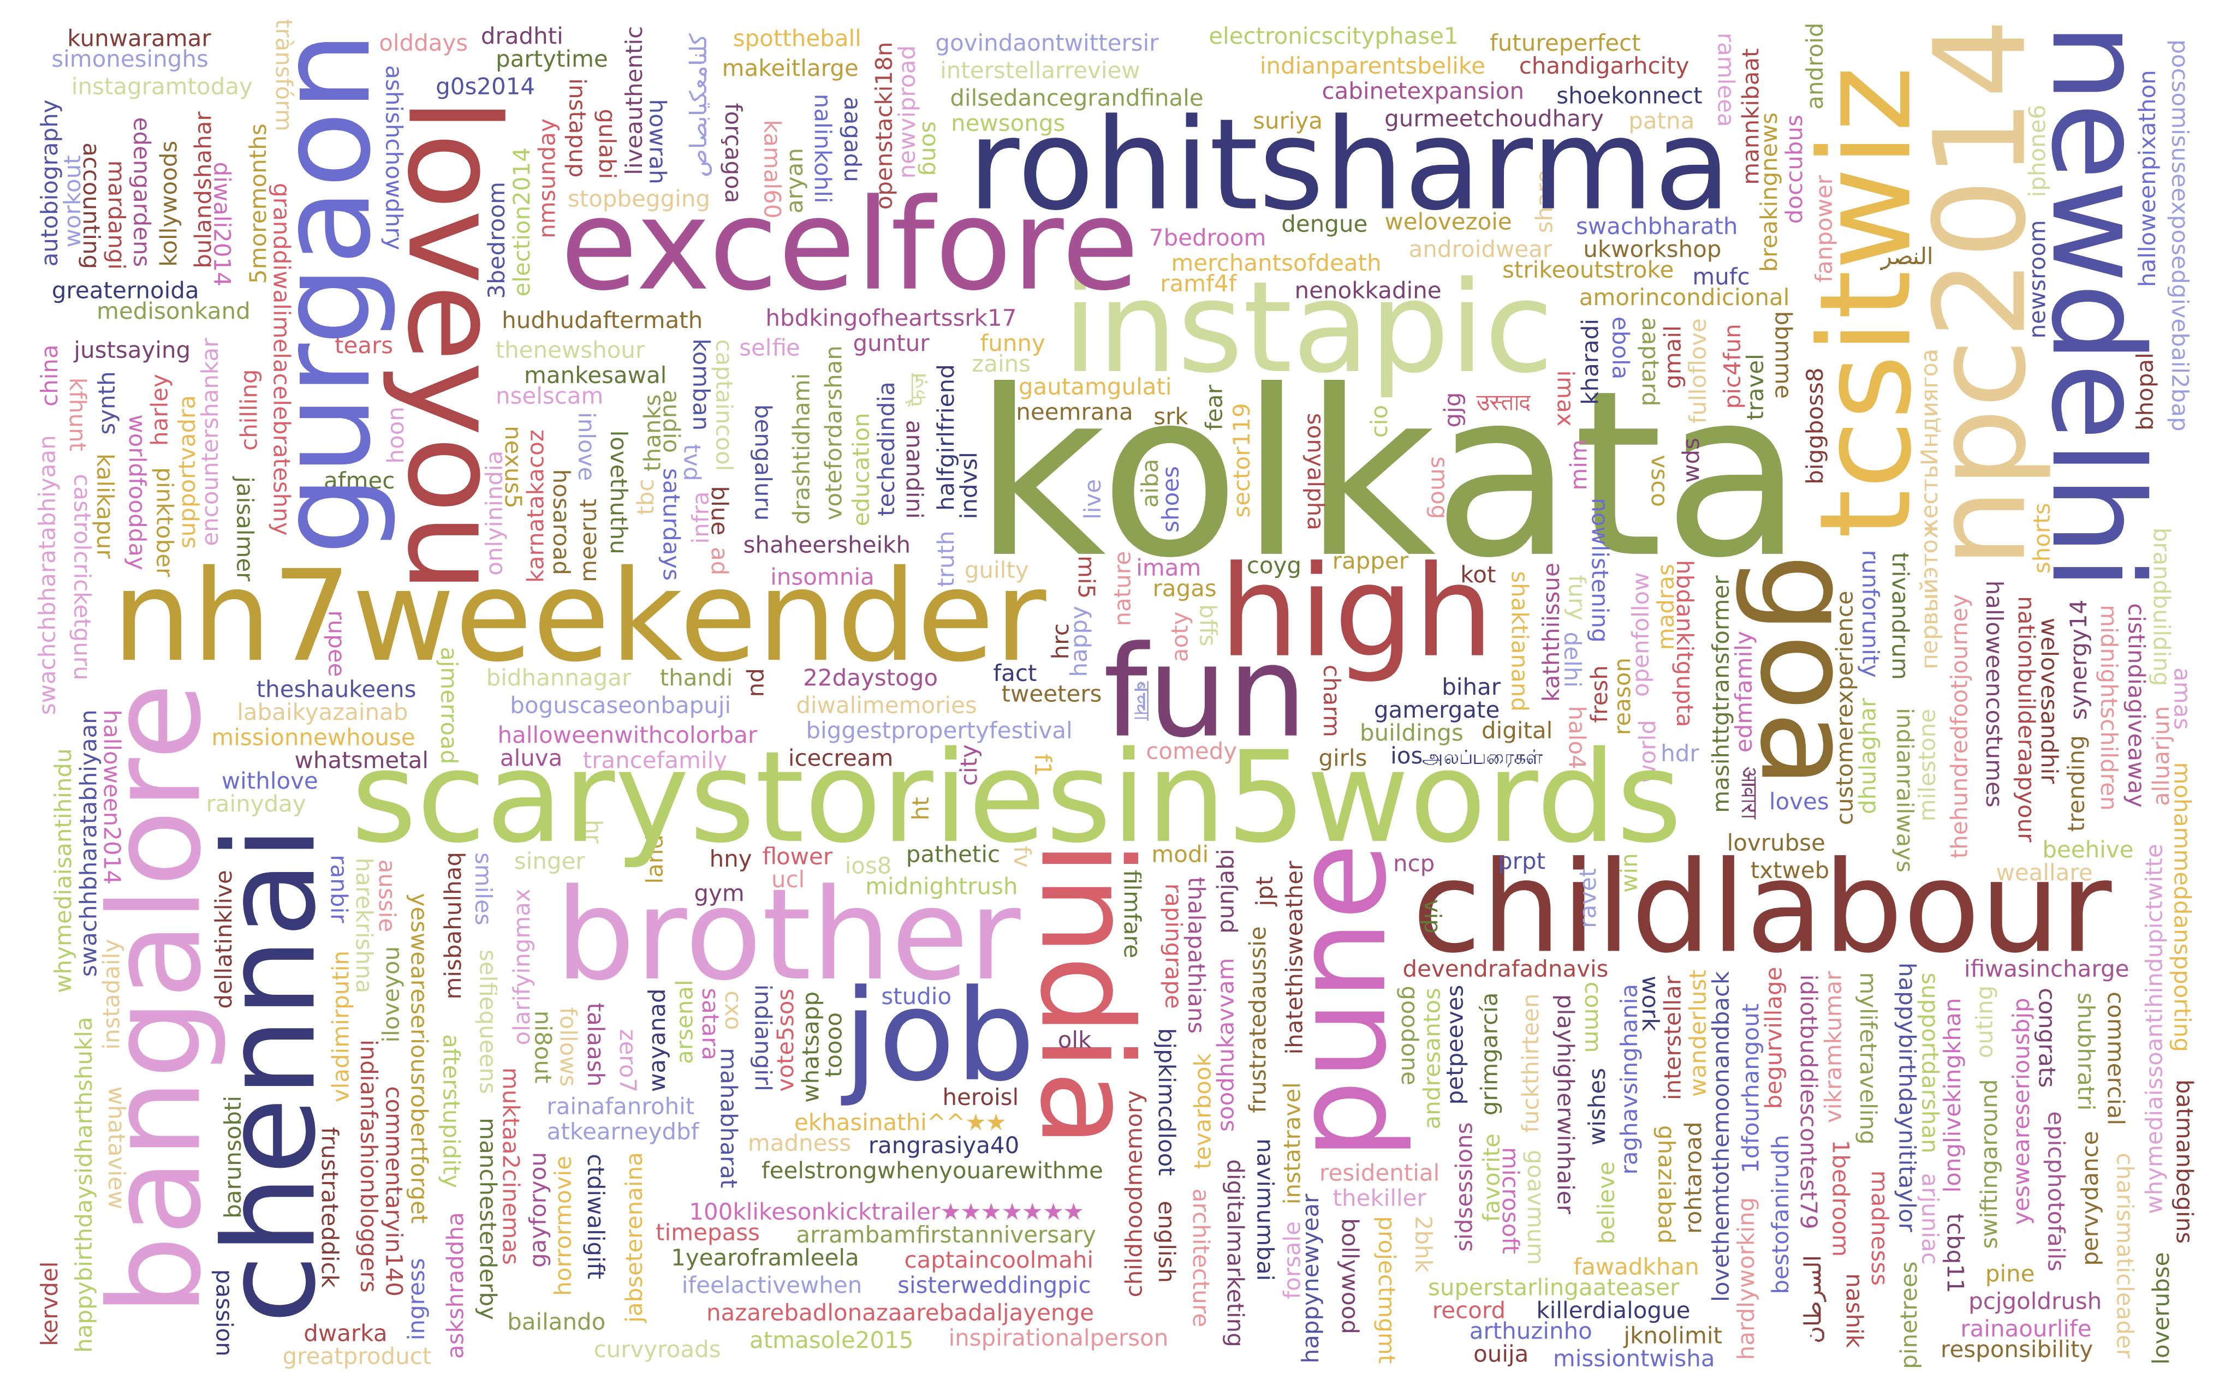
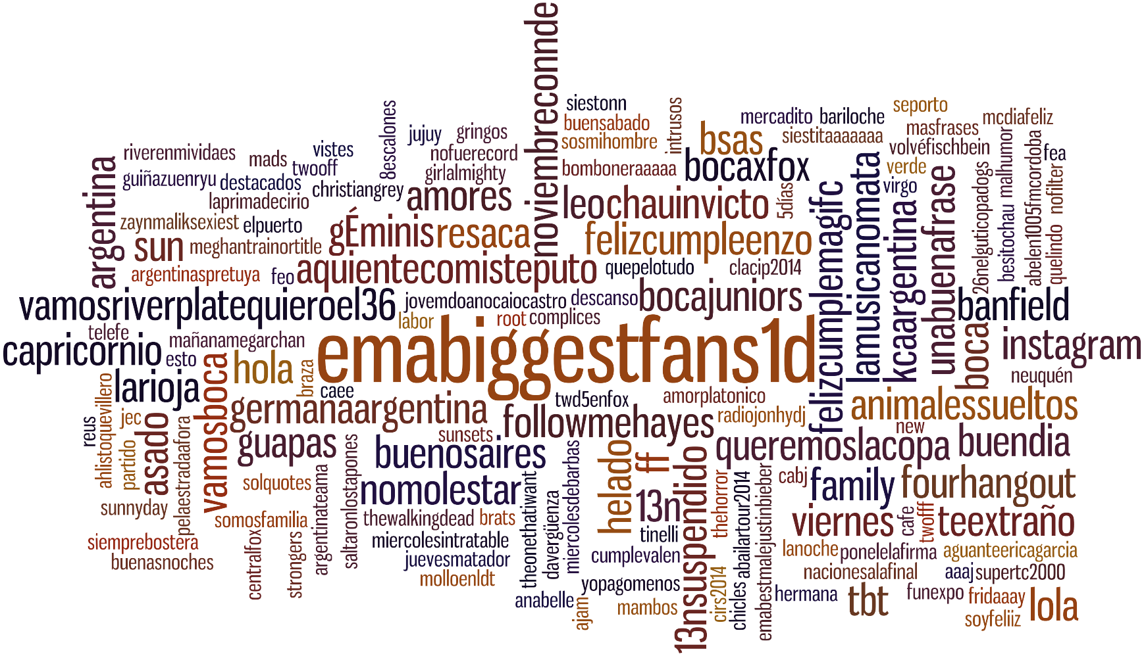
Topics of Interest
Stratum 1 Japan
Stratum 3 Indonesia
Stratum 4 India
Stratum 2 Argentina

Slide 21
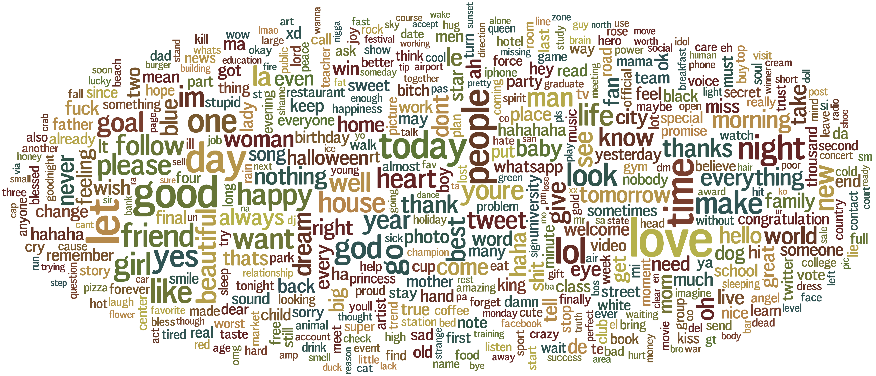
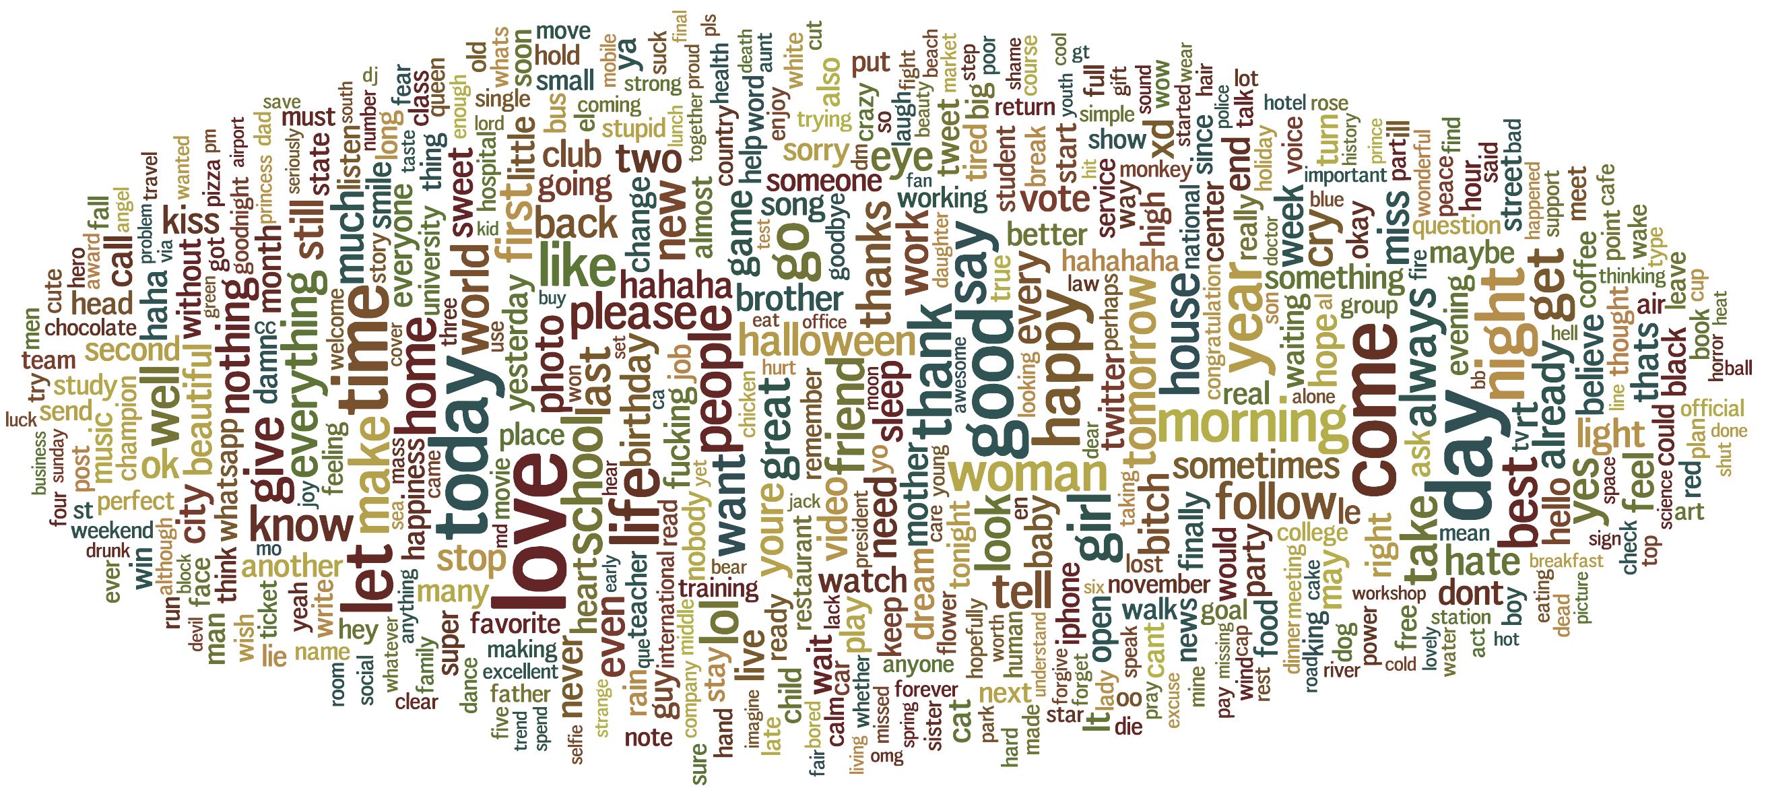
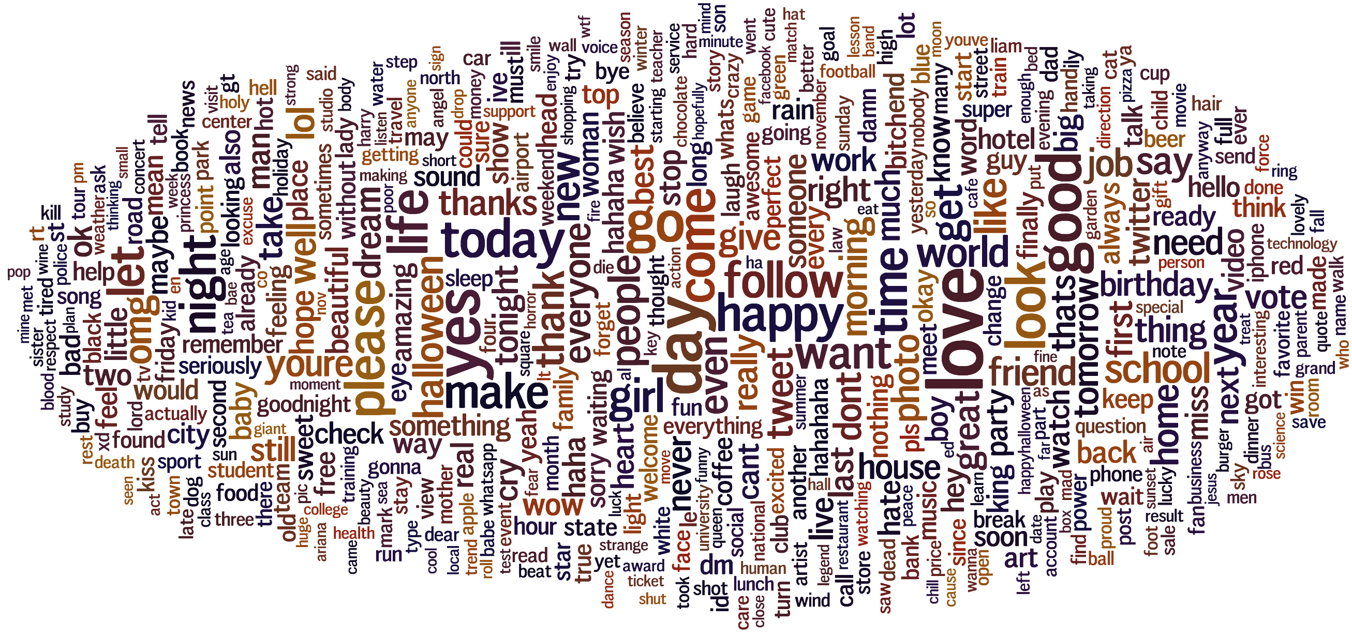
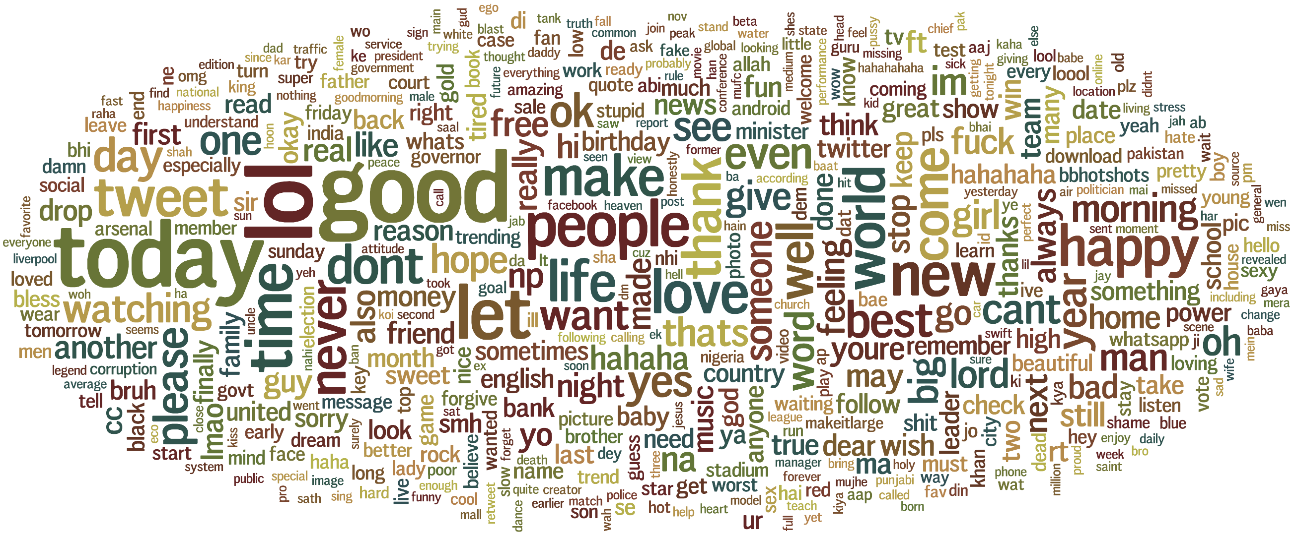
Topics of Interest - words
Stratum 1
Stratum 3
Stratum 4
Stratum 2

Slide 22
Conclusion
Purpose:
Find the cheapest way to analyze main socioeconomic indices
Findings
Human Development Index doesn’t tell much about global patterns

Slide 23
Thank You

